Slide 1

BANK MARKETING
By Team: Data Dynamo

Slide 2
Team Members
TEAM MEMBERS | CONTRIBUTIONS
Meghanjali Chennupati | Data Collection, Data Exploration
Mounica Pothureddy | Data Collection, Data Exploration
Aarsha Joji | Data analysis and Modelling
Shambhavi Mishra | Data analysis and Modelling
Pradeep Reddy | Data Evaluation, PPT

Slide 3
Business Problem
The direct marketing campaigns for a Portuguese banking institution, relying on phone calls, face the challenge of efficiently determining whether a client will subscribe to the bank term deposit ('yes') or not ('no').
Efficiently addressing this predictive classification challenge enhances the bank's marketing effectiveness, streamlining efforts for maximum subscription success rates while minimizing resource expenditure, ultimately contributing to customer satisfaction and financial growth in a competitive banking environment.

Slide 4
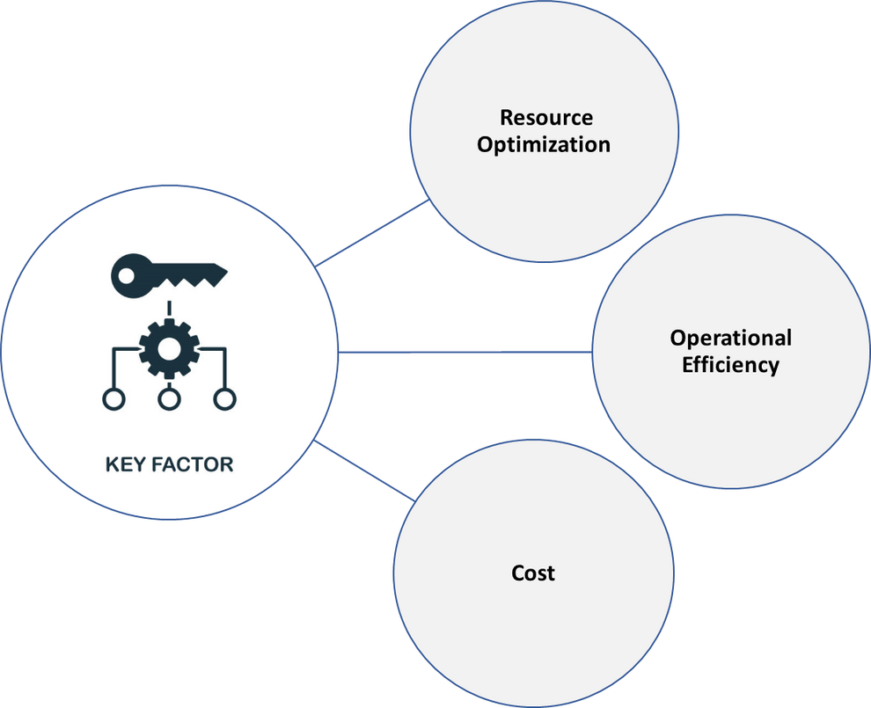
Key Factors

Slide 5

Objective
The project's aim is to construct a predictive model for a binary classification problem, with a focus on optimizing resource allocation and marketing efficiency. The goal is to accurately classify clients as likely ('yes') or unlikely ('no') to subscribe to a term deposit, ultimately fostering increased customer satisfaction and sustaining financial growth in the competitive banking sector.

Slide 6
Sources of Data
The dataset is sourced from a Portuguese banking institution and pertains to direct marketing campaigns, specifically focusing on whether clients will subscribe to a term deposit or not.
https://archive.ics.uci.edu/dataset/222/bank+marketing

Slide 7
Data Description
The data consists of 41188 observations.
The age, duration, campaign, etc were the attributes of the dataset.
The target variable, denoted as 'y,' assumes values of 'yes' or 'no,' indicating whether the client subscribes to the term deposit or not.

Slide 8
Attributes
age
education
default
pdays
y
marital
contact
housing
previous
month
emp_var_rate
Duration
day_of_week
euribor3m
nr_employed
Campaign
cons_conf_idx
poutcome
job
cons_price_idx
loan

Slide 9
Data Analysis/Modeling
Data Exploration
Data Cleaning
Models used:
Logistic
Decision
Linear SVC
MLP Classifier

Slide 10
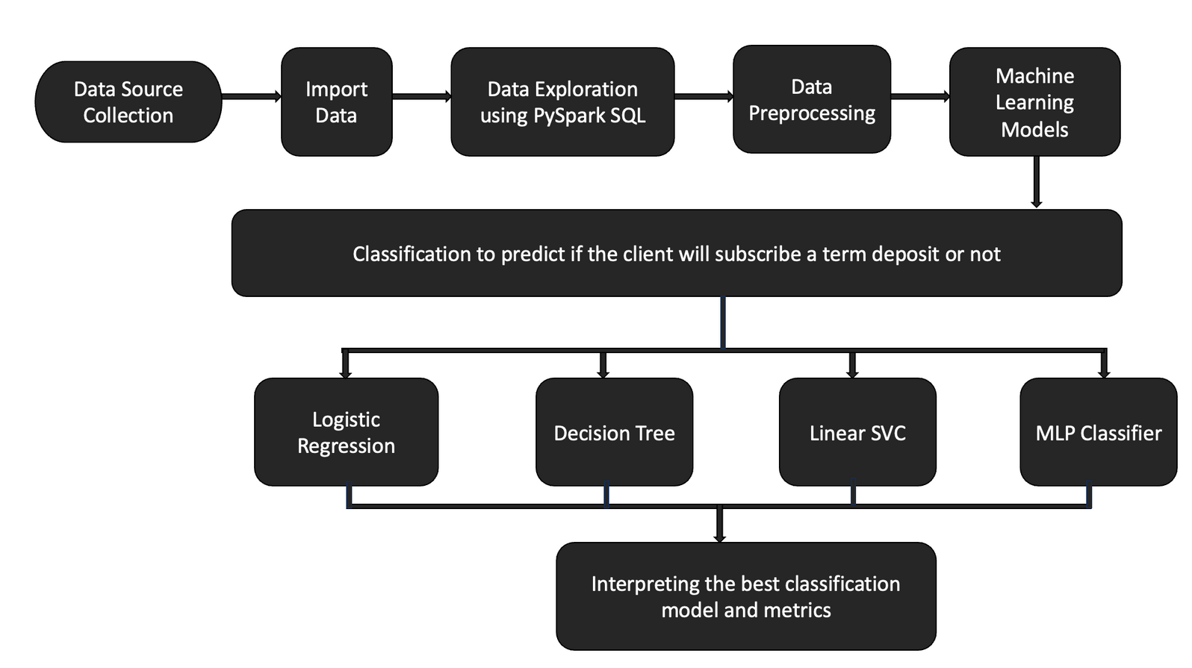
DataFlow Model

Slide 11
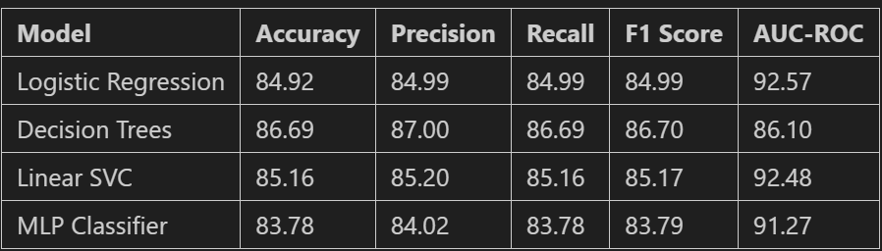
Model Results

Slide 12
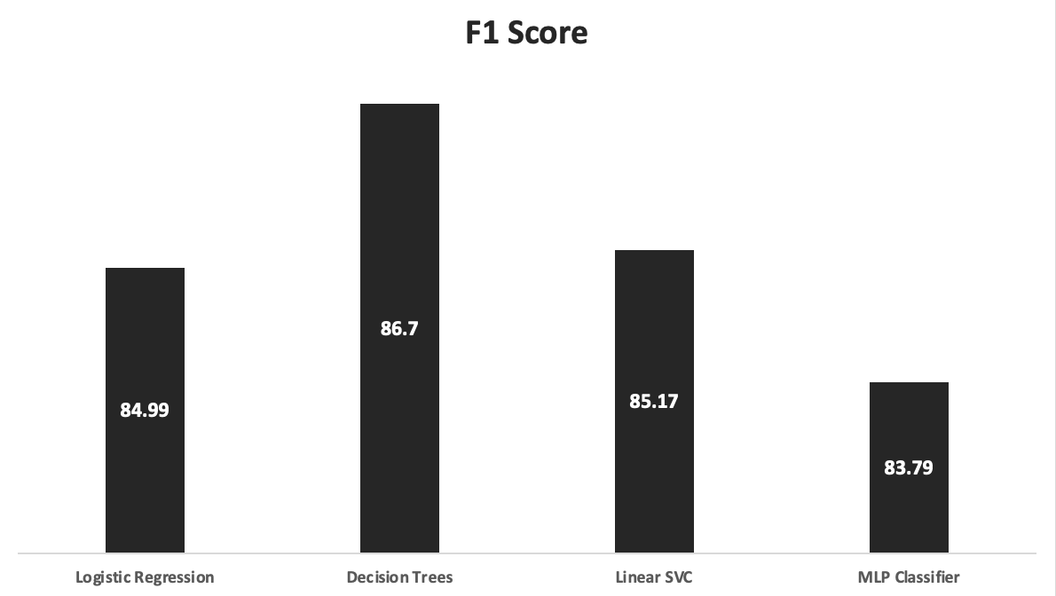
Model Results

Slide 13
Challenges
Data Imbalance Mitigation: Implemented strategies to rectify data imbalance issues within the dataset.
Standardization of Attribute Values: Employed standardization techniques, specifically utilizing the standard scalar technique, to normalize the distribution of attribute values spanning a wide range.
Categorical Variable Encoding: Utilized string indexer to encode categorical variables, ensuring compatibility with analytical models.
Attribute Name Standardization: Adjusted attribute names to adhere to established standards, promoting consistency and facilitating clearer interpretation.

Slide 14
Future Perspective
Employ boosting and bagging techniques, including XG Boost, Adaboost, and RandomForest, to enhance the modeling process and achieve improved predictive results.
Utilize the 'duration' column in the dataset to construct advanced deep learning models such as deep neural networks and sequential neural networks like RNN, aiming for enhanced predictive capabilities.
Explore additional data sources, such as online and offline survey results, alongside call-related data, to enrich the analysis.
Prioritize the implementation of robust security measures to safeguard collected data, ensuring resilience against breaches.
Regularly analyze customer feedback to iteratively enhance strategies, ensuring alignment with customer needs and maintaining competitiveness in the market.

Slide 15
Cost Benefits
Our problem statement is a binary class classification
False Positives may lead to misallocated resources and financial risks related to credit extension and regulatory compliance.
False Negatives lead to missed revenue opportunities and averting a competitive disadvantage by ensuring effective engagement with potential subscribers.
True Positives are pivotal as they enable the bank to precisely predict customer subscriptions, facilitating targeted marketing efforts, product customization, and enhanced customer satisfaction, ultimately driving increased loyalty and revenue.
True Negatives are crucial as they enable efficient resource allocation by accurately predicting customers who will not subscribe, allowing the bank to divert resources to optimize marketing budgets, and enhance overall campaign efficiency.
Leveraging equal consideration for both False Positives and False Negatives, we choose the F1 score as the best metric.

Slide 16
Conclusion
Successfully tackled data imbalance using the Random Over Sampler technique
Conducted thorough data exploration to identify key influencers on our target variable
Uncovered a positive correlation between the number of employees and employment variability during data analysis, providing valuable insights.
Based on our analysis, the Decision Tree algorithm emerged as the optimal choice, exhibiting superior performance with an F1 score of 86.7%.

Slide 17
Related links
GitHub code link- https://github.com/Anjali-16/BD-Final-project

Slide 18

Thank You!

